Slide 1
Fluid Mechanics Wrap Up
CEE 331
December 18, 2012

Slide 2
Inclined Surface Findings
The horizontal center of pressure and the horizontal centroid ________ when the x or y axis is a line of symmetry for the surface
The center of pressure is always _______ the centroid
The vertical distance between the centroid and the center of pressure _________ as the surface is lowered deeper into the liquid
The center of pressure is at the centroid for horizontal surfaces
0
coincide
below
decreases

Slide 3
Linear Momentum Equation
F_{p2}
M₂
F_{ssx}
The momentum vectors have the same direction as the velocity vectors
M₁
F_{ssy}
F_{p1}
W

Slide 4
Vector Addition
θ₂
cs₂
y
x
cs₁
cs₃
θ₁
θ₃

Slide 5
EGL (or TEL) and HGL
The energy grade line may never be horizontal or slope upward (in direction of flow) unless energy is added (______)
The decrease in total energy represents the head loss or energy dissipation per unit weight
EGL and HGL are ____________and lie at the free surface for water at rest (reservoir)
Whenever the HGL falls below the point in the system for which it is plotted, the local pressures are lower than the __________________
pump
coincident
reference pressure

Slide 6
HGL and EGL
velocity head
pressure head
energy grade line
hydraulic grade line
z
elevation
pump
z = 0
datum
How do you find the slope of the EGL if you know Q?
How would you find the lowest pressure in this pipeline?

Slide 7
Control Volume Summary
Control volumes should be drawn so that the surfaces are either tangent (no flow) or normal (flow) to streamlines.
In order to solve a problem the flow surfaces need to be at locations where all but 1 or 2 of the energy terms are known
The control volume can not change shape over time
When possible choose a frame of reference so the flows are steady

Slide 8
Dimensionless Parameters
Reynolds Number
Froude Number
Weber Number
Mach Number
Pressure
Drag Coefficients

Slide 9
Problem solving approach
Identify relevant forces and any other relevant parameters
If inertia is a relevant force, than the non dimensional Re, Fr, W, M numbers can be used
If inertia isn’t relevant than create new non dimensional force numbers using the relevant forces
Create additional non dimensional terms based on geometry, velocity, or density if there are repeating parameters
If the problem uses different repeating variables then substitute (for example ωd instead of V)
Write the functional relationship

Slide 10
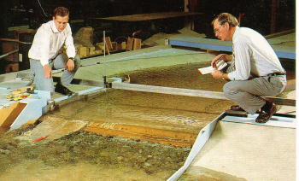
Froude similarity
Froude number the same in model and prototype
________________________
define length ratio (usually larger than 1)
velocity ratio
time ratio
discharge ratio
force ratio
1
difficult to change g
1
1

Slide 11
Force ratios
Fr
Re

Slide 12
Force Balance on Flow through Circular Tubes
Velocity
Shear
Laminar flow
True for Laminar or Turbulent flow

Slide 13
Laminar Flow Friction Factor
Hagen-Poiseuille
Darcy-Weisbach
-1
Slope of ___ on log-log plot

Slide 14
Laminar Flow
Pressure drop along pipe, laminar flow
Pressure drop is observed to be proportional to distance between pressure taps
Find how pressure drop varies with pipe diameter as a function of the velocity

Slide 15
Moody Diagram
0.10
0.08
0.05
0.06
0.04
0.03
0.05
0.02
0.04
0.015
0.01
0.008
friction factor
0.006
0.03
0.004
laminar
0.002
0.02
0.001
0.0008
0.0004
0.0002
0.0001
0.01
0.00005
smooth
1E+03
1E+04
1E+05
1E+06
1E+07
1E+08
Re

Slide 16
Reflection on Moody
Does head loss decrease as velocity increases?

Slide 17
Experimental Results
Explain gradual transition between laminar and turbulent
Why might experimental results indicate larger f in laminar region as Re increases?

Slide 18
Length for uniform flow to establish in pipes
Re is based on diameter here!

Slide 19
Flat Plate Drag Coefficients
1 x 10⁻³
5 x 10⁻⁴
2 x 10⁻⁴
1 x 10⁻⁴
5 x 10⁻⁵
2 x 10⁻⁵
1 x 10⁻⁵
5 x 10⁻⁶
2 x 10⁻⁶
1 x 10⁻⁶

Slide 20
Viscous Drag on Ships
The viscous drag on ships can be calculated by assuming a flat plate with the wetted area and length of the ship
scales with ____ (based on _______ similarity)
L_{r}³
Froude

Slide 21
Minor Losses
How are minor losses measured?
How did you measure expansion loss?
Why don’t the minor losses simply add up if you place several elbows close together?
What assumption is required for the minor loss coefficients to be given as a constant?
High Re

Slide 22
Drag Coefficient on a Sphere
1000
100
Stokes Law
Drag Coefficient
10
1
0.1
0.1
1
10
10²
10³
10⁴
10⁵
10⁶
10⁷
Re=500000
Reynolds Number
Turbulent Boundary Layer

Slide 23
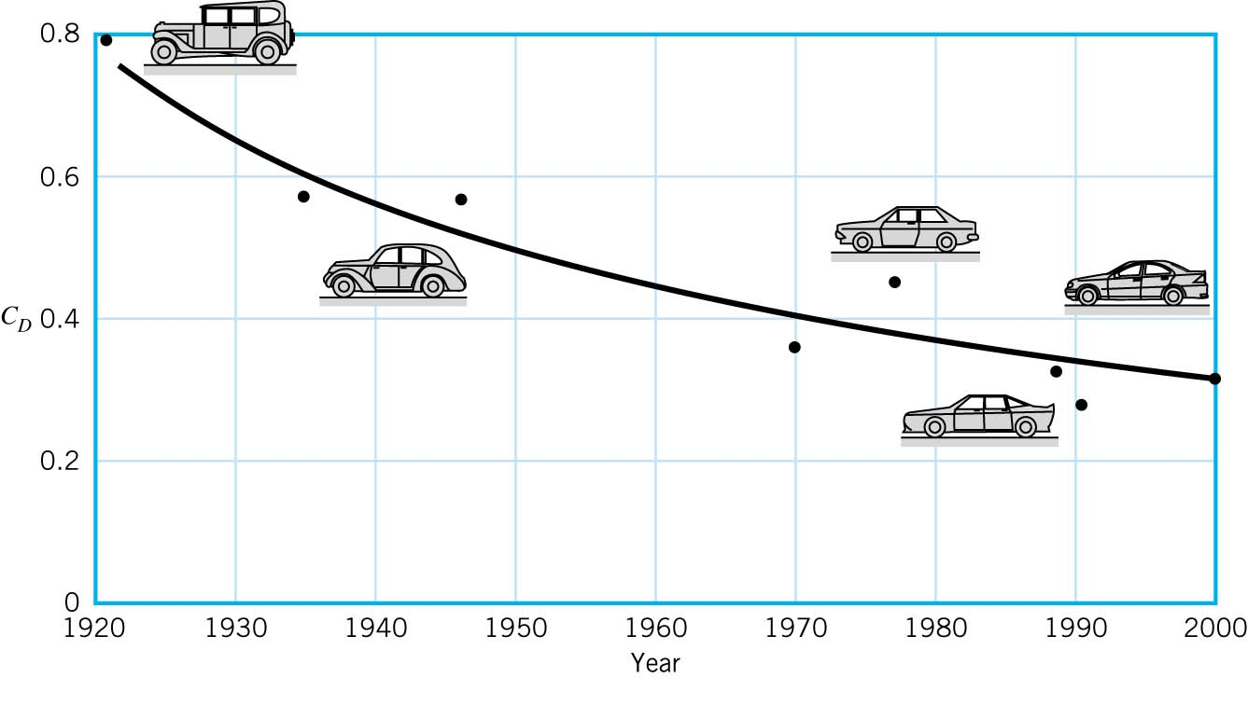
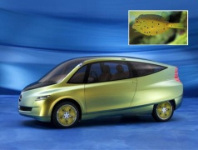
SUVs have got Drag…
Ford Explorer 2002 C_{d} = 0.41

Slide 24

Boxfish car
C_{d} of 0.19!

Slide 25
Drag Coefficients
Flat plate (A=?)
Other objects (A=?)
Viscous drag (wetted area)
Pressure drag (projected area)
Total drag (projected area)

Slide 26
More Fluids?
Hydraulic Engineering (CEE 332 in Spring 2006)
Hydrology
Measurement Techniques
Model Pipe Networks (computer software)
Open Channel Flow (computer software)
Pumps and Turbines
Design Project
Sustainable Small-Scale Water Supplies (CEE 454 Fall 2006)
Fluid mechanics of gravity powered water supplies
Point of use water treatment
Transport, Mixing, and Transformation in the Environment (CEE 655 Fall)

Slide 27
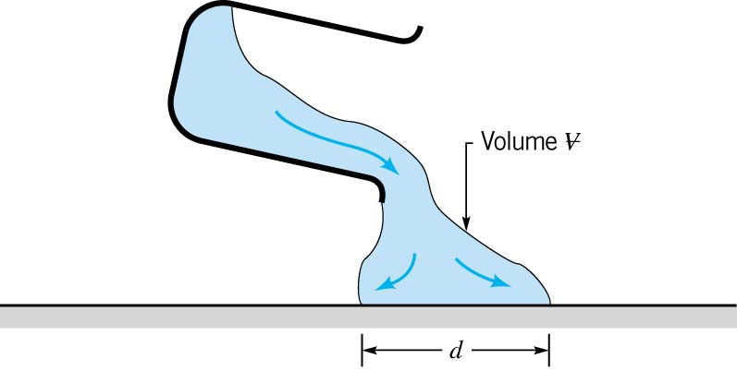
7.15

Slide 28
7.16
Drag on supersonic aircraft

Slide 29
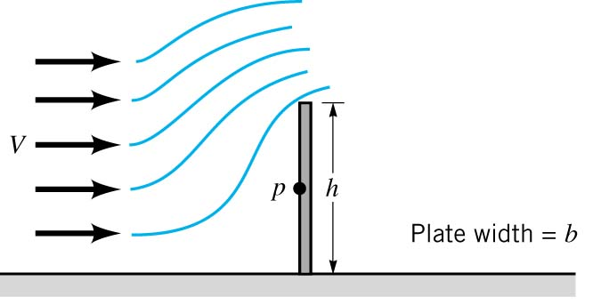
7.17

Slide 30
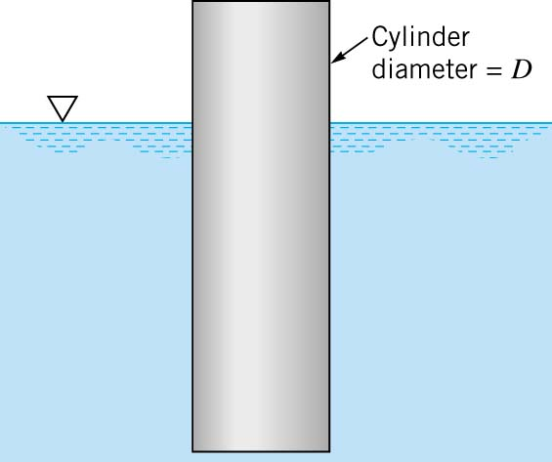
7.20

Slide 31
7-14

